Slide 1


Ahmed Seif
15th June 2022

Slide 2

Outline
Executive Summary
Introduction
Methodology
Results
Conclusion
Appendix

Slide 3
Executive Summary
Summary of methodologies
Data Collection through API
Data Collection with Web Scraping
Data Wrangling
Exploratory Data Analysis with SQL
Exploratory Data Analysis with Data Visualization
Interactive Visual Analytics with Folium
Machine Learning Prediction
Summary of all results
Exploratory Data Analysis result
Interactive analytics in screenshots
Predictive Analytics result

Slide 4
Introduction
Dataset Info
The SpaceX dataset compiles crucial data related to Falcon 9 rocket launches. It includes variables such as launch cost, rocket specifications, and the success rate of first stage landings, instrumental for gauging launch cost efficiency. This resource is particularly useful for alternate companies planning to compete with SpaceX's launch services, enabling them to strategize based on accurate, market-leading benchmarks.
Project Objective
Develop a predictive model using the SpaceX dataset to accurately forecast the success of the first stage landing of Falcon 9 rockets. This prediction will help in determining the cost of each launch, thereby providing valuable insights for alternate companies planning to competitively bid against SpaceX for rocket launches.

Slide 5


Slide 6
Methodology
Executive Summary
Data collection methodology:
Data was collected using SpaceX API and web scraping from Wikipedia.
Perform data wrangling
Perform exploratory data analysis (EDA) using visualization and SQL
Perform interactive visual analytics using Folium and Plotly Dash
Perform predictive analysis using classification models

Slide 7

Data Collection – SpaceX API
We used the get request to the SpaceX API to collect data, clean the requested data and did some basic data wrangling and formatting.
The link to the notebook is https://github.com/chuksoo/IBM-Data-Science-Capstone-SpaceX/blob/main/Data%20Collection%20API.ipynb.

Slide 8
Data Collection - Scraping
Using BeautifulSoup library in Python
Collected data over Wikipedia
Parsed html files with requests and html5lib to conduct data into tables
Saved collected data to a Pandas Dataframe

Slide 9
Data Wrangling
EDA (Exploratory Data Analysis) to:
Identify dataset key features
Clean missing values
Get a detailed version of the dataset
Determine training labels

Slide 10
Data Visualization EDA
Visualizations talk better than words, This is why conducting a visualized report is needed
Among the Visualization EDA, there was found that:
Rocket missions has developed over the years 2013-2020
Over the years, The payload masses has increased as well as the success rate
The heliosynchronous orbit, had only one mission and it failed

Slide 11
EDA with SQL
SQL has always been a useful tool for Data Analysis, featuring JOIN and other data manipulation statements. Exploring the data with sql turned out to show:
Successful missions over data was 35 missions
Only F9 B5 Boosters could carry the 15,600 KG payloads
Total Payloads sent to space was around 45,600 KG

Slide 12
Build an Interactive Map with Folium
Folium is an interactive map visualizer, Using folium, detected that:
Launch sites are at least 50KM away from cities
Launch sites are around 6 KM away from highways
1 KM away from railway stations and coastlines

Slide 13
Build a Dashboard with Plotly Dash
Plotly Dash is a mix of tools that use flask server to display interactive visualizations on the web, using them we assured that:
Development over years that successful missions completed increased year by year
Highest Success rate for a launch site was around 80% of missions launched from there
Launch Sites are strongly correlated to payload masses

Slide 14
Predictive Analysis (Classification)
Using classification techniques, SVM, Decision Trees, Logistic Regression and KNN classifier:
Actually no classifier showed a better accuracy than the other and all of them tended to cover around 84% accuracy for detection of success-to-failure of missions

Slide 15
Results
Exploratory data analysis results
Interactive analytics demo in screenshots
Predictive analysis results

Slide 16


Slide 17
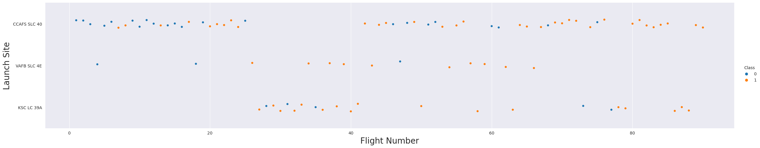
Flight Number vs. Launch Site
From the plot, we found that the larger the flight amount at a launch site, the greater the success rate at a launch site.

Slide 18
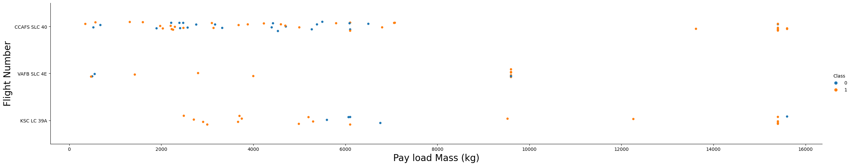
Payload vs. Launch Site
The higher the payload mass the more successful missions are

Slide 19
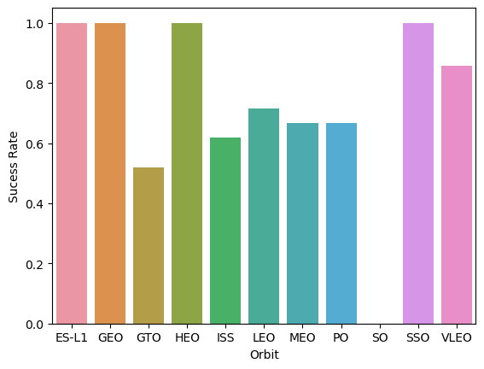
Success Rate vs. Orbit Type
SO had No successful attempts
ES-L1, GEO, HEO, SSO orbits are very successful

Slide 20
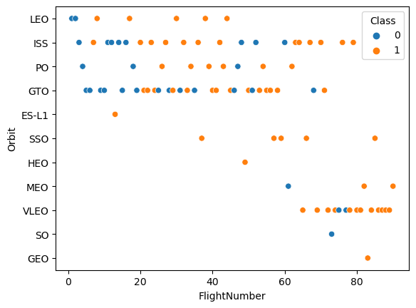
Flight Number vs. Orbit Type
VLEO, had been the most recent orbit and it appears to be very sucessful
ISS as well has good overall succession rates

Slide 21
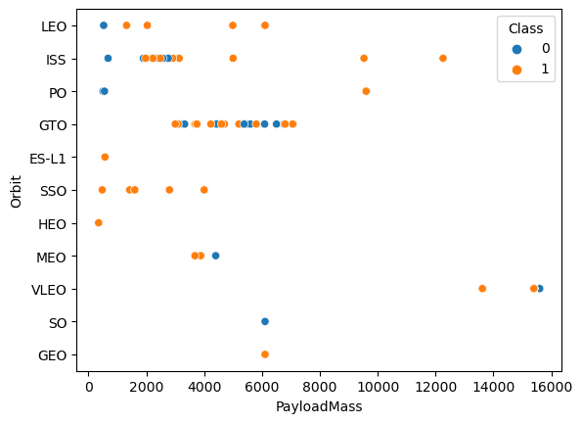
Payload vs. Orbit Type
SSO has been used for lightweighted payloads
At heavier loads PO, ISS, VLEO are very successful as well

Slide 22
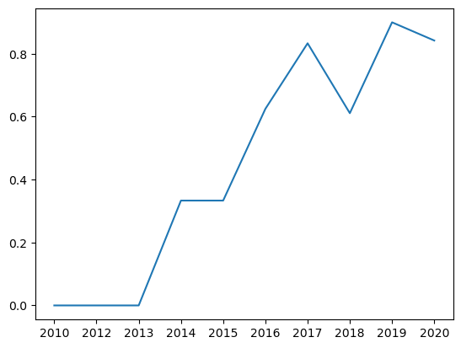
Launch Success Yearly Trend
Development since 2013 till 2020 Affected higher success rates

Slide 23
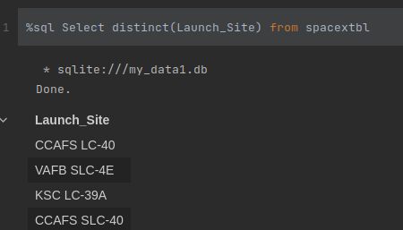
All Launch Site Names
Using SQL, We can see that there are only 4 Launch Sites that SpaceX rockets are launched from
CCAFS LC-40
CCAFS SLC-40
VAFB SLC-4E
KSC LC-39A

Slide 24
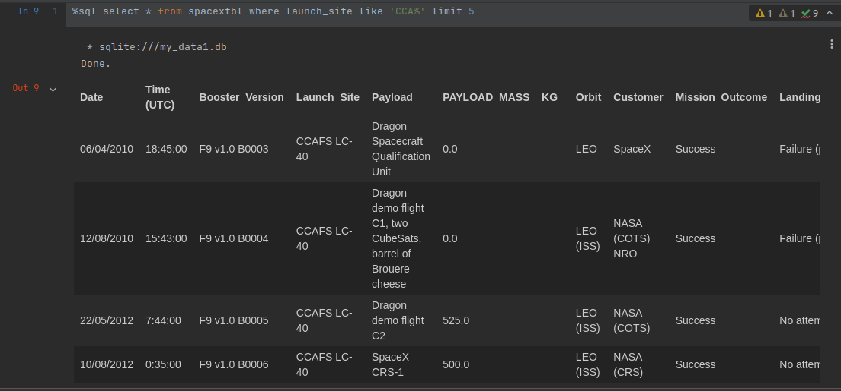
Launch Site Names Begin with 'CCA'
Top First 5 launches was successful missions on CCA* Launch Sites

Slide 25
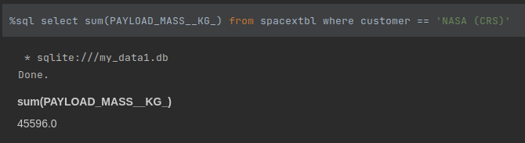
Total Payload Mass
NASA’s Total payloads were around 45600 KG

Slide 26
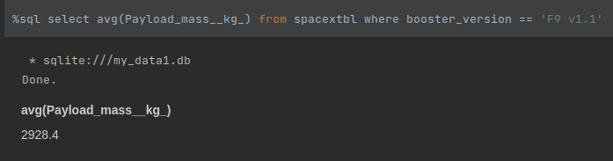
Average Payload Mass by F9 v1.1
Around 2928 KG

Slide 27
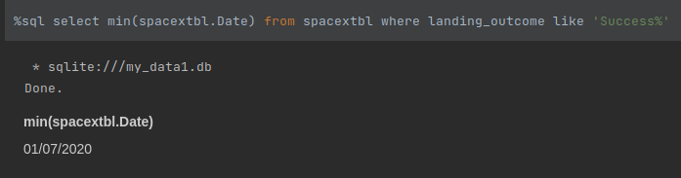
First Successful Ground Landing Date
January 2020

Slide 28
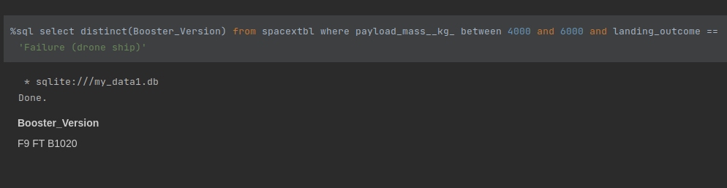
Successful Drone Ship Landing with Payload between 4000 and 6000

Slide 29
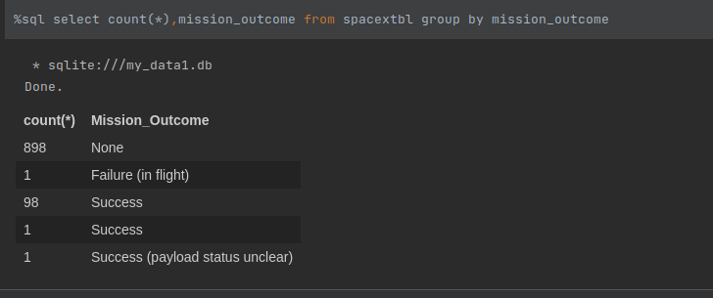
Total Number of Successful and Failure Mission Outcomes
Around 100 Missions Success and only 1 Failure

Slide 30
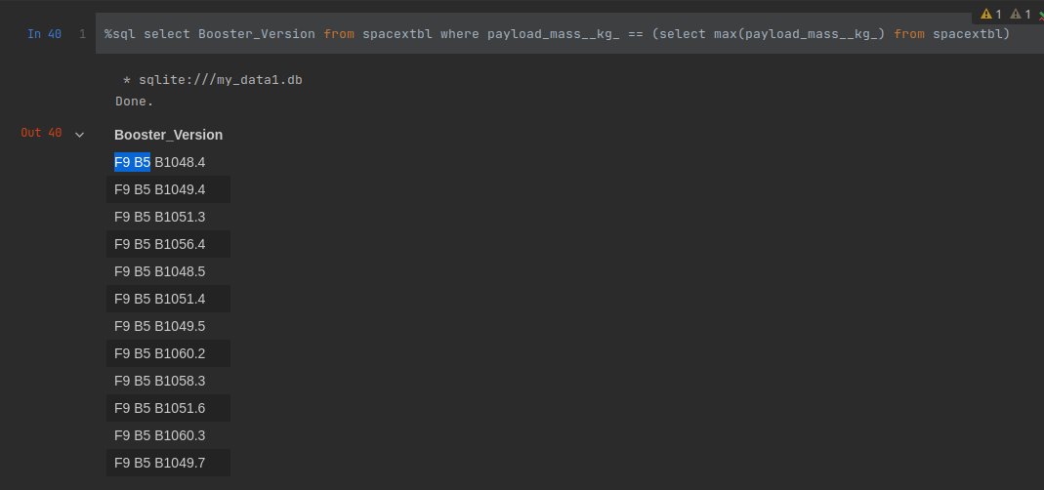
Boosters Carried Maximum Payload

Slide 31
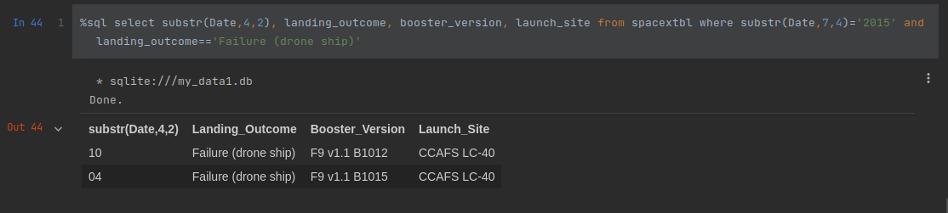
2015 Launch Records
April and October been failure landing months for 2015

Slide 32
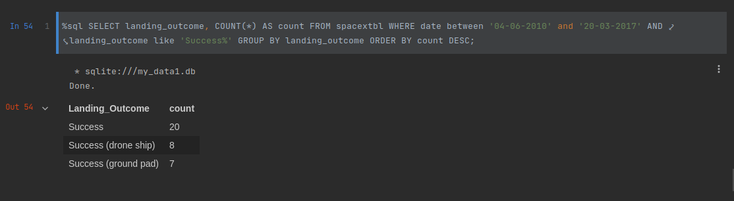
Rank Landing Outcomes Between 2010-06-04 and 2017-03-20
Applying Count, Where, Between, Like, Group By and Order By Statments to view successful landings between June 2010 and March 2017

Slide 33


Slide 34
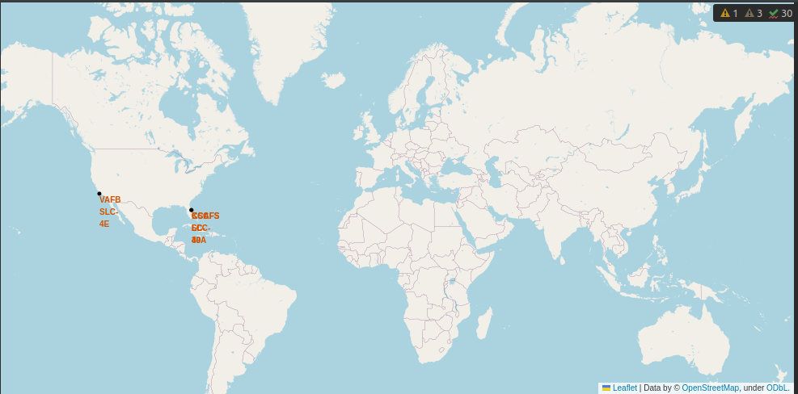
All launch sites global map markers

Slide 35

Markers showing launch sites with color labels

Slide 36

Launch Site distance to landmarks

Slide 37


Slide 38
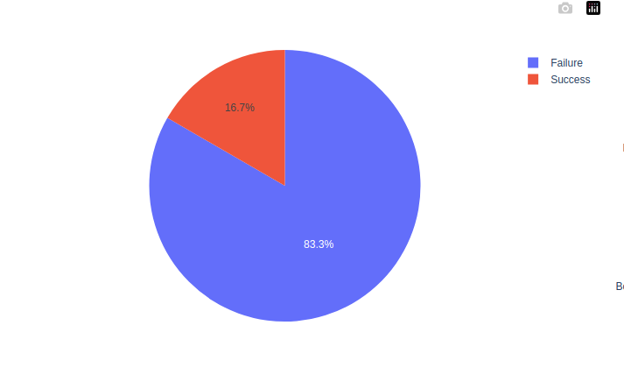
Failure and Success Total rates for 2017

Slide 39
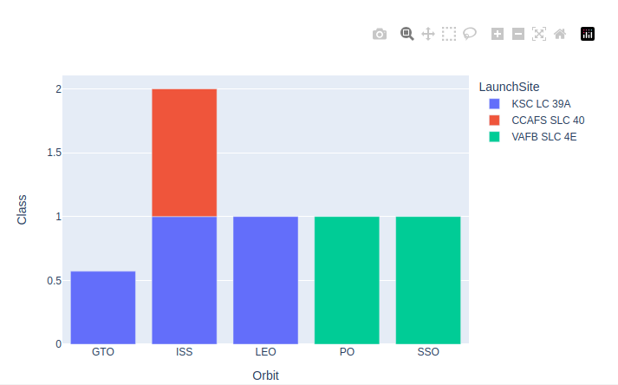
Success Rates for Orbits with Launch sites Base in 2017

Slide 40


Slide 41
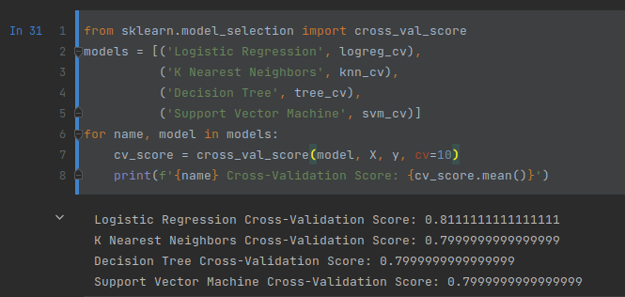
Classification Accuracy
Logistic Regression has scored the best cross validation score with 81%

Slide 42
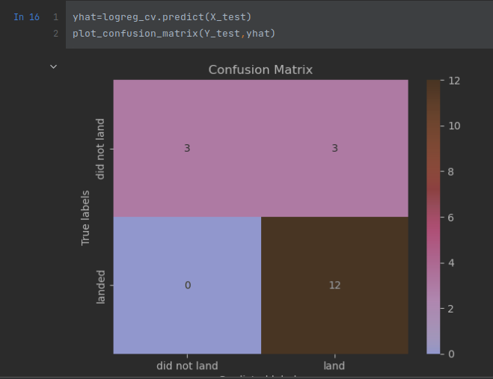
Confusion Matrix
The confusion matrix for the Logistic Regression shows that the classifier can distinguish between the different classes. The major problem is the false positives .i.e., unsuccessful landing marked as successful landing by the classifier.

Slide 43
Conclusions
We can conclude that:
Development since 2013 to 2020 had great impact on landing rockets
Orbits more far to the earth tend to show better success rates
Logistic Regression can be the best classifier at 10 cross validations for the current dataset
There’s a very strong correlation between launch sites and payload masses

Slide 44


